Slide 1
Aeromedical regulations in covid times

Slide 2
Guidelines in relation to the COVID-19 pandemic

Slide 3
Purpose and applicability
Guidance for AeMCs, AMEs, GMPs and OHMPs
Class 1,2,3, LAPL and CC
Part-Med infectious diseases - compatibility
Recommendations on
Mgt act infection cases
Ctl measures avoid new infect
Medical assessors NCA : consultations, referrals, secondary review.

Slide 4
Background
Return to flying after
Disease
Asymptomatic carrier
Infected
Longterm sequelae
Pulmonary functional tests (required by Part MED)
Risk of transmission
Other applicants
Medical staff
Vaccin

Slide 5
COVID-19 symptoms (most common)
Fever
Dry or productive cough
Asthenia
Dyspnoea
Sore throat
Headache
Myalgie or arthralgia
Shivers
Naussea or vomiting
Nasal congestion
Diarrhoea
Haemoptysis
Conjunctival congestion

Slide 6
COVID-19 symptoms (less frequent)
Neurological : dizziness, altered level of consciousness, stroke,ataxia, epilepsy, neuralgia and Guillain-Barré dyndrome
Cardiological : heart failure or acute myocardial damage
Ophtalmological : dry eye, blurred vision, foreign body sensation and conjunctival congestion
Otolaryngology : facial pain, nasal obstruction, olfactory and taste dysfunction
Dermatological injuries
Haematological : thrombotic phenomena or bleeding

Slide 7
Sciensano : definition of possible case
A possible case of COVID-19 is a person with at least one of the following main symptoms, arising acutely, without other apparent cause: cough; dyspnoea; thoracic pain; acute anosmia or dysgeus;
OR at least two of the following symptoms, with no other apparent cause: fever; muscle aches; fatigue; rhinitis; sore throat; headache; anorexia; watery diarrhoea; acute confusion; sudden fall;
OR exacerbation of chronic respiratory symptoms (COPD, asthma, chronic cough...), without other apparent cause.

Slide 8
Laboratory diagnosis
Nucleic acid tests : detect presence of viral RNA
RT-PCR (polymerase chain reaction) cycle threshold 30
RT-LAMP
Antigen tests : detect presence of a viral antigen
RADT (Rapid Antigen Detection Tests)
Antibody tests : detect presence of antibodies
ELISA
CLIA
LFA
Whole genome sequencing (variants)

Slide 9
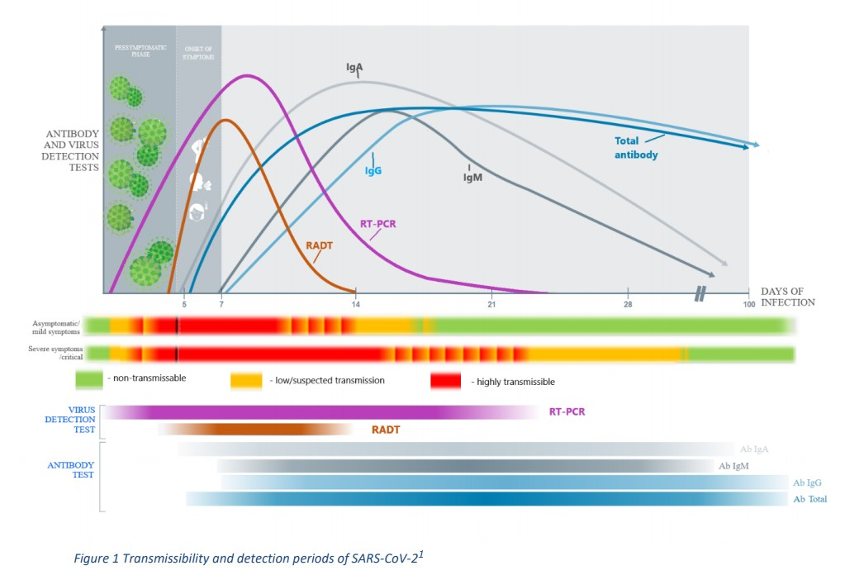

Slide 10
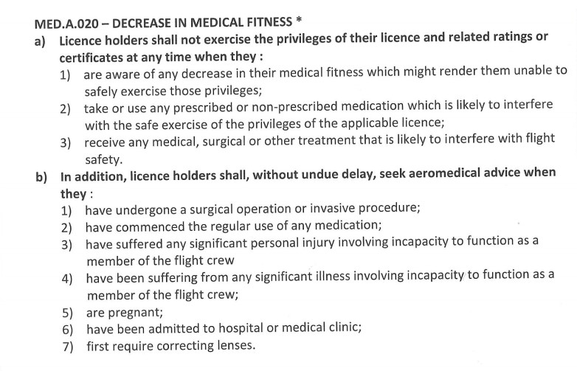
Aero-medical examination and assessment
Decrease of medical fitness
MED.A.020 / ATCO.MED.A.020
MED.A.050 Referral
Respiratory system
MED.B.015 / ATCO.MED.B.015 / AMC3.MED.B.095
Infectious diseases
MED.B.040 / ATCO.MED.B.040 / AMC8.MED.B.095
MED.C.025 Content of aero-medical assessments (cabin crew)

Slide 11
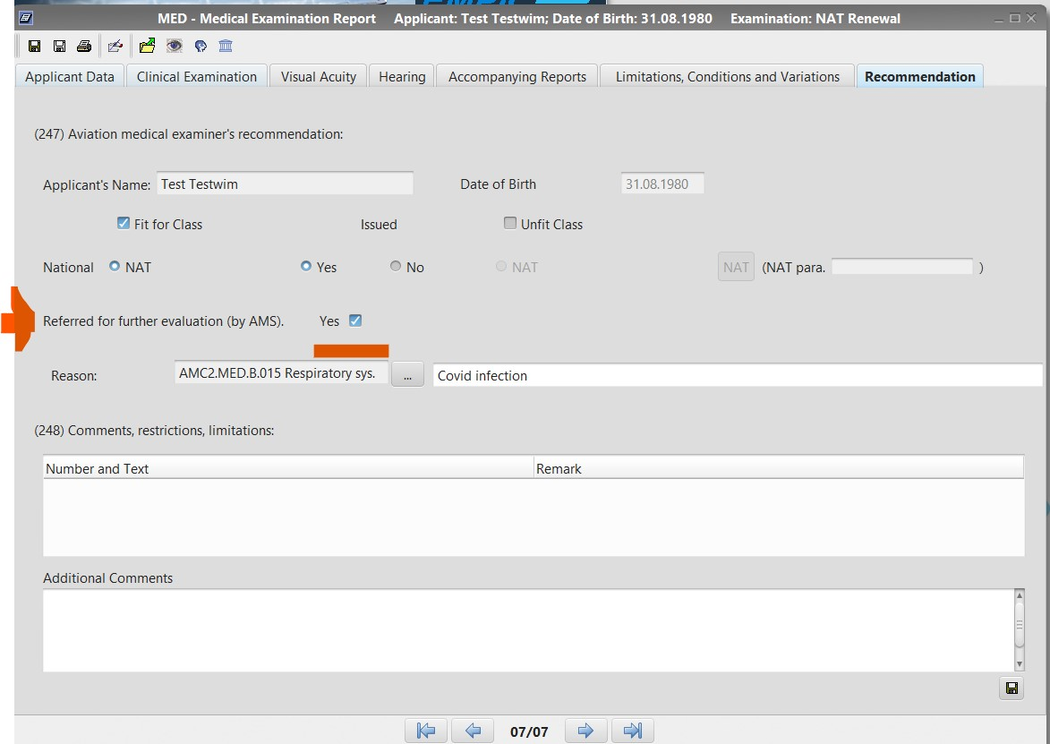

Slide 12
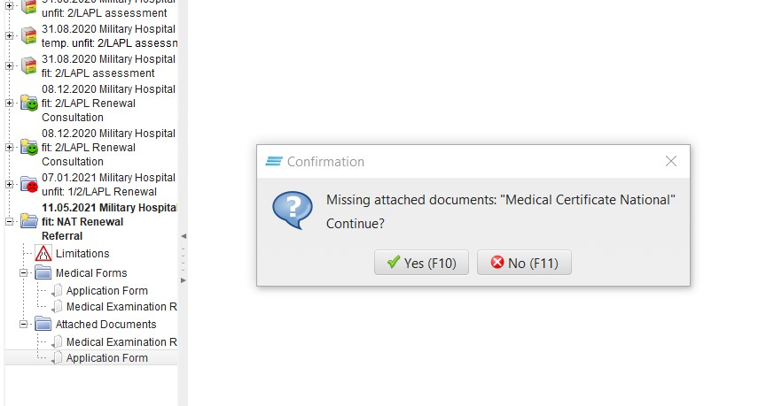

Slide 13
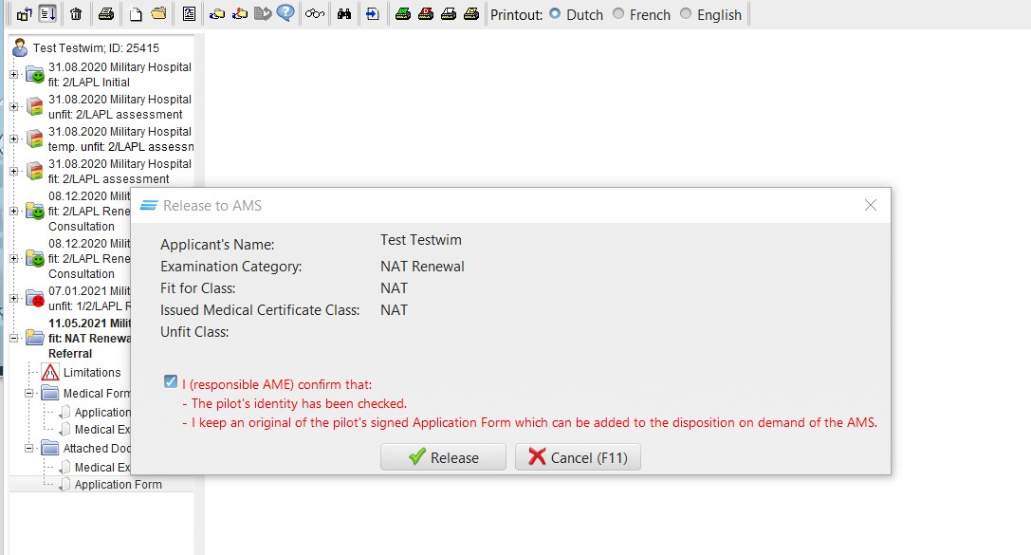

Slide 14
Assessment
Medical reports, occupational health status
Diagnosis
Course of treatment, hospital admission
Oxygen therapy, assisted ventilation
Complementary testing
Labo, image diagnosis ..
Comorbidity and complications
Preventive measures, quarantine

Slide 15
Additional testing by AME
Temp
Computed Tomography
Thoracic echography
Pulmonary function test
SpO2 follow-up
Dyspnea scale (MRC) & quality of life
6 min walk test,
ECG
Echocardiography
Target organs involvement and specialist report

Slide 17
Pulmonary function tests
Required for initial class 1 and 3
Neg PCR (within 24 hours)
Desinfection
Symptomatic applicants

Slide 18
Vaccin
No regulatory restrictions preventing aviation personnel to get vaccinated
Part MED of regulation (EU) 1178/2011
Part ATCO.MED of regulation (EU)2015/340
Approved by EMA
Adverse reactions

Slide 19
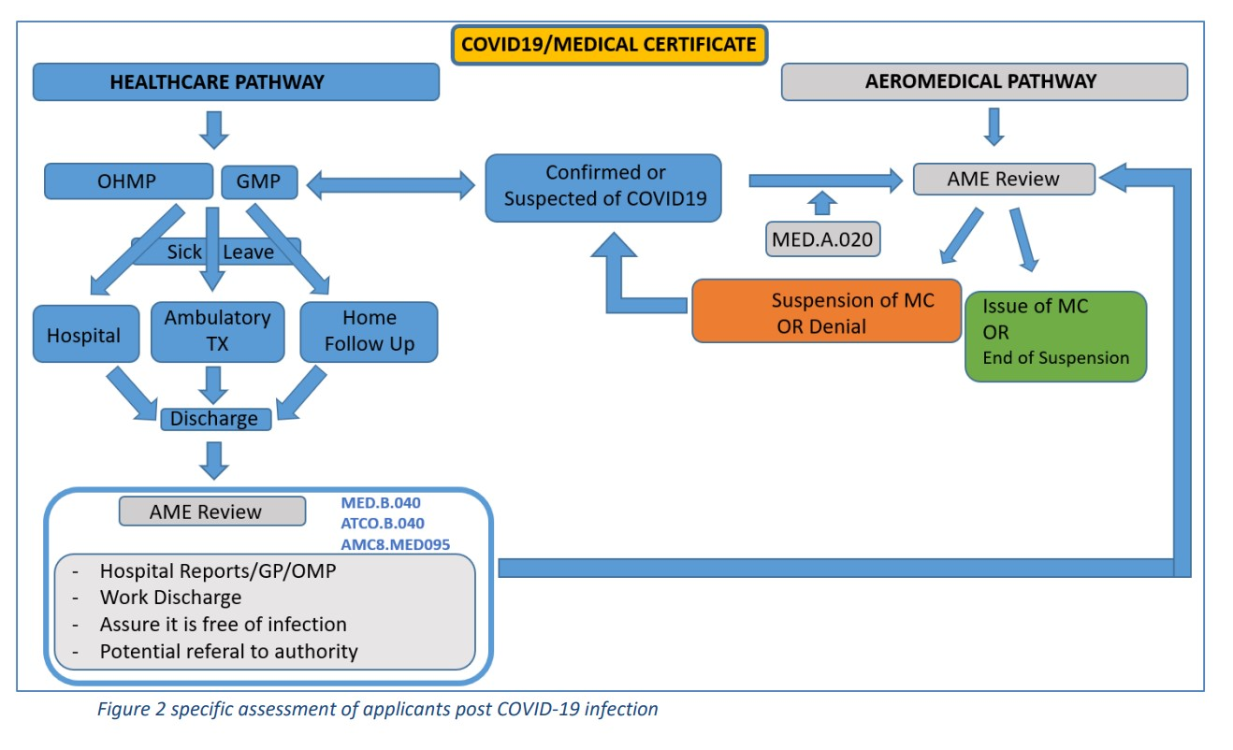

Slide 20
Flow charts
1 : PCR test + 1°
Asymptomatic
Light symptoms
Moderate - severe
2 : Symptoms
1° episode ? PCR test
3 : Asymptomatic
1° episode ?

Slide 21
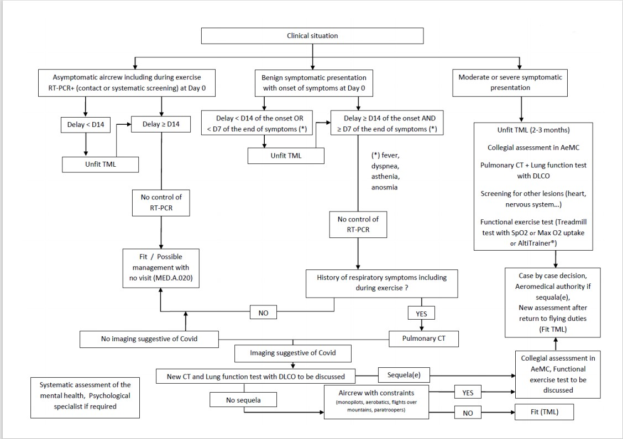

Slide 22
Asymptomatic (including exercise) Test + at day 0
Contact or systematic screening
Delay of 14 days
No control of PCR
Fit > 14 days
Possible management with no visit (MED.A.020)

Slide 23
Benign symptoms Onset of symptoms at day 0
Delay 14 days (onset) 7days (end of symptoms)
Delay onset >= D14 AND End of symptoms >= D7
No control of PCR
History of respiratory symptoms (including during exercise)
Yes : Pulmonary CT
No : Fit , possible management with no visit (MED.A.020)

Slide 24
Pulmonary CT
Neg : fit
Pos , suggestive of Covid :
New CT and lung function test with DLCO to be discussed
Sequela
No sequela, aircrew with constraints (monopilots, aerobatics, paratroopers, flights over mountains)
(Collegial assessment in AeMC, functional exercise test to be discussed.
Case by case decision, NCA, Unfit, Fit (TML))
No sequela aircrew with no constraints
(Fit (TML))

Slide 25
CO-RADS score Covid reporting and data system / CT grafische probabiliteit covid 19

Slide 26
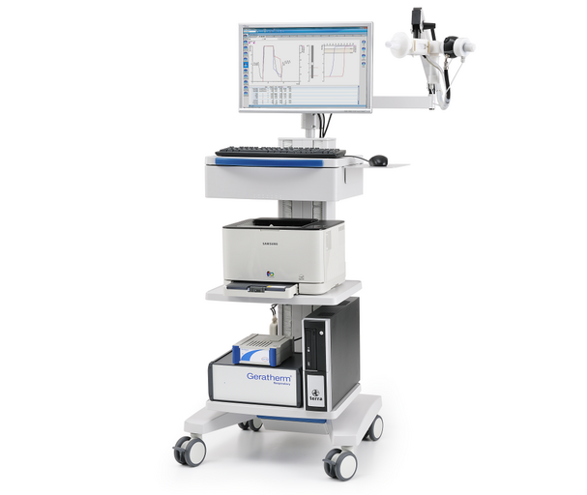
DLCO

Slide 27
Moderate or severe symptomatic presentation
Unfit TML (2- 3 months)
Collegial assessment in AeMC
Pulmonary CT + lung function test with DLCO
Screening for other lesions (heart, nervous system…)
Functional exercise test (Treadmill test with SpO2 or Max O2 uptake or Alti Trainer)
Case by case decision, NCA, Fit TML

Slide 28
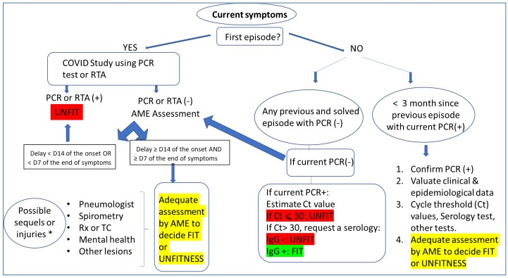

Slide 29
Current symptoms / first episode
PCR + / RTA + UNFIT
PCR – / RTA -
Delay <D14 of the onset OR <D7 end of sympt
UNFIT
Delay >D14 of the onset AND >D7 end of sympt
Assessement by AME

Slide 30
Current symptoms / NOT first episode
PCR –
Delay <D14 of the onset OR < D7 end of sympt
UNFIT
Delay >D14 of the onset AND > D7 end of sympt
Assessement by AME
PCR +
Cycle threshold
<30 unfit
>30 : IgG - : UNFIT IgG + : FIT
PCR + (previous episode < 3 month)
Valuate clinical /epidemio data
Ct / IgG IgM …
Assessement AME

Slide 32
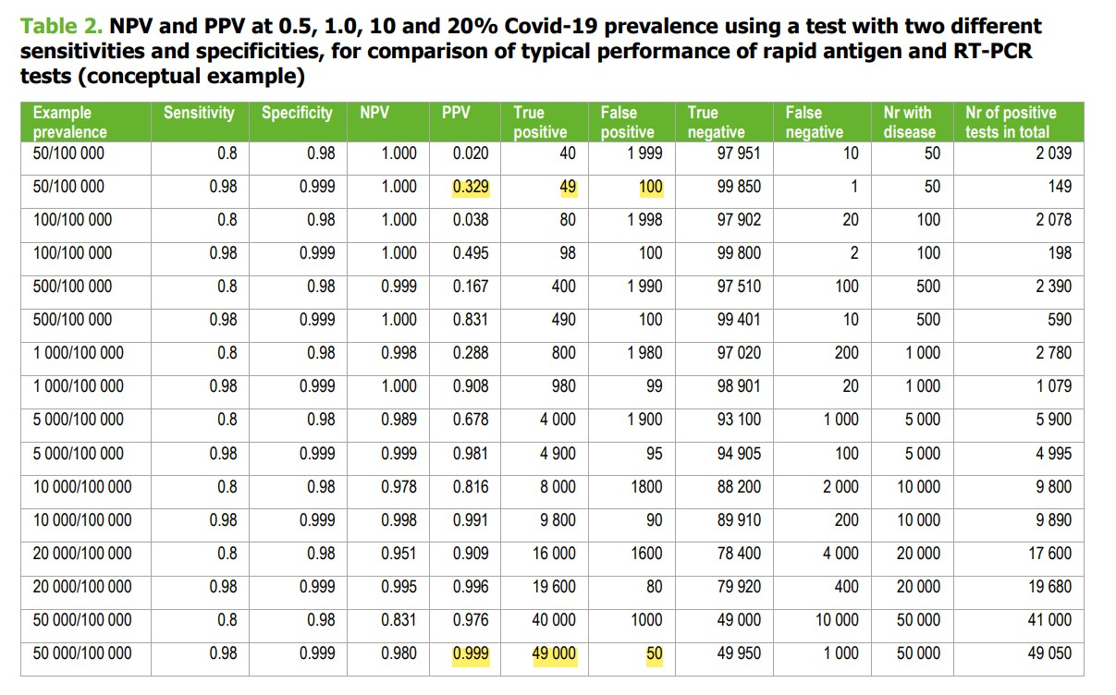

Slide 34
Conclusions and recommendations
Syndromic expression
Variable clinical course (mild until ICU care)
Psychological and mental status changes (mental health interview)
Family or acquaintance mourning
Long stay in ICU
Financial
Changes in work schedule

Slide 35
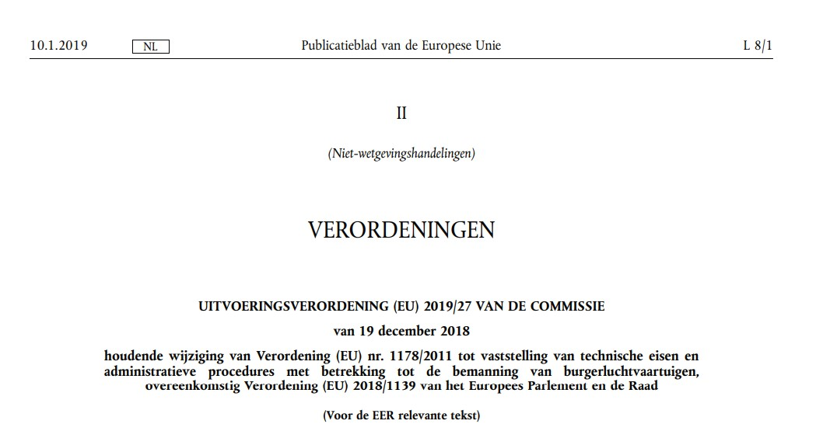

Slide 36
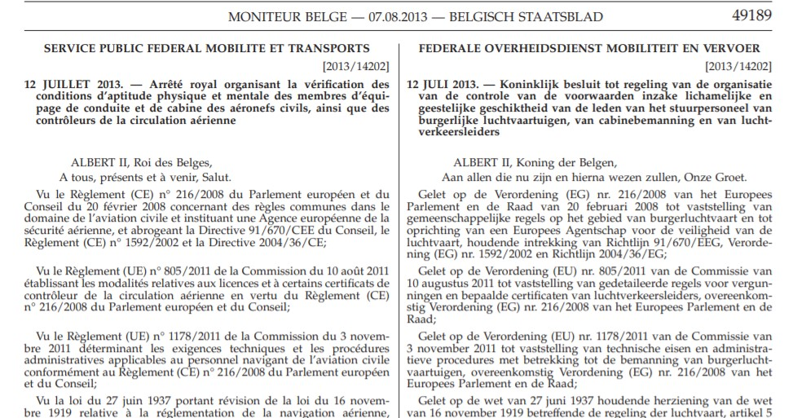

Slide 37
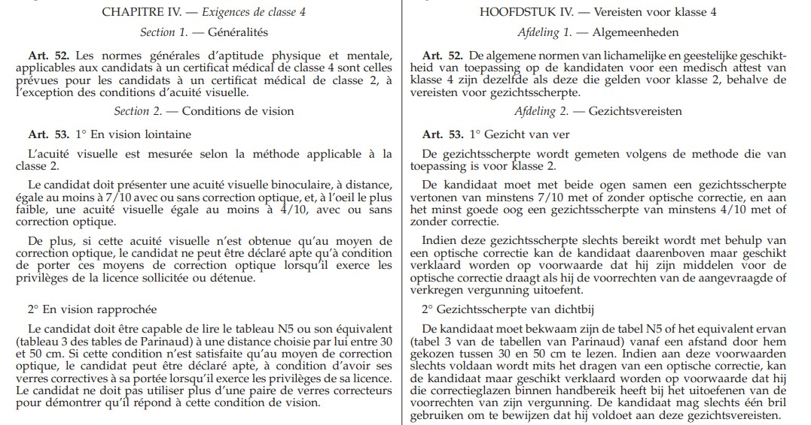

Slide 38
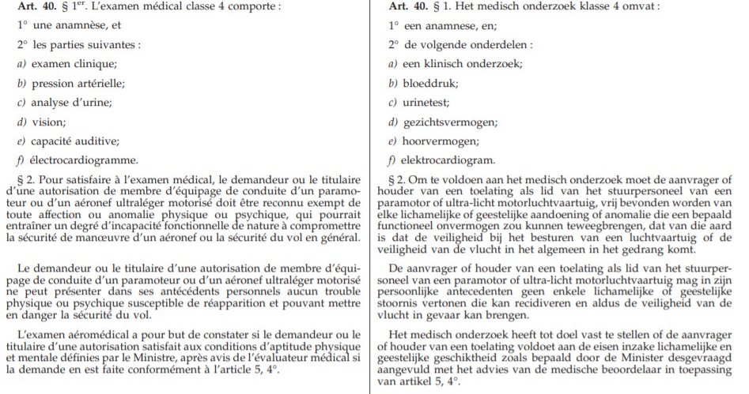

Slide 39
OML/OSL OPL/ORL

Slide 40
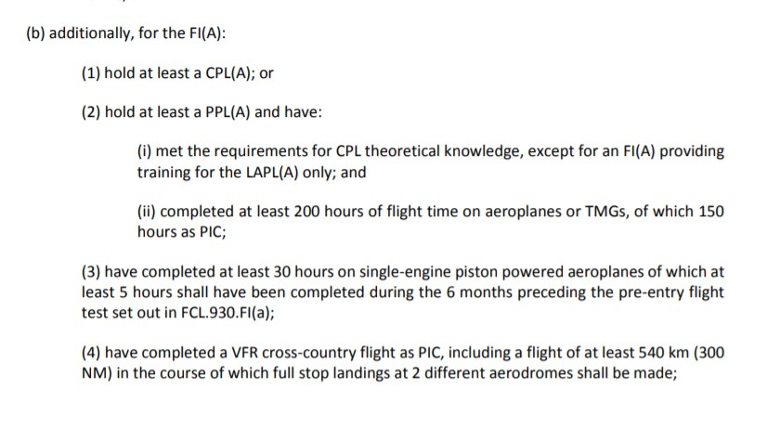
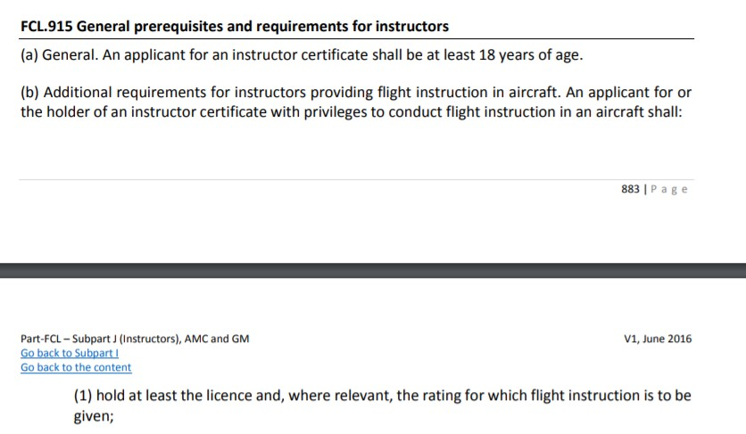

Slide 41
Class 1 thromboembolic

Slide 42
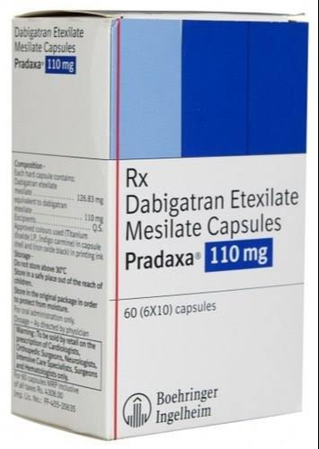
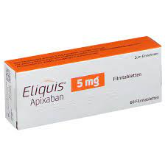
Acceptable DOACS
Dabigatran
Rivaroxaban
Apixaban

Slide 43
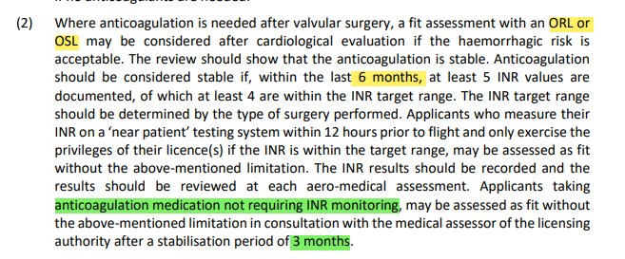
Class 2 tromboembolic

Slide 44
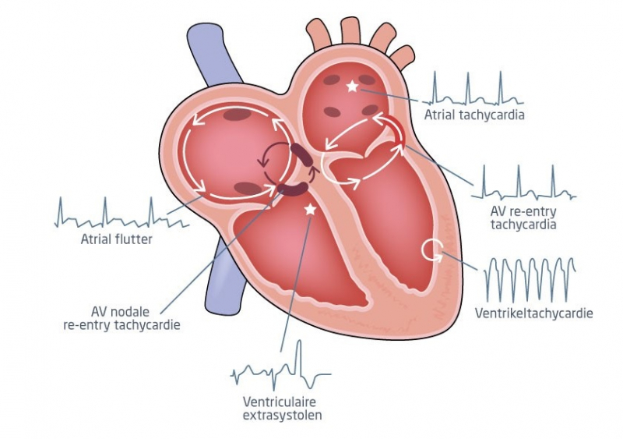
Ablatie

Slide 45
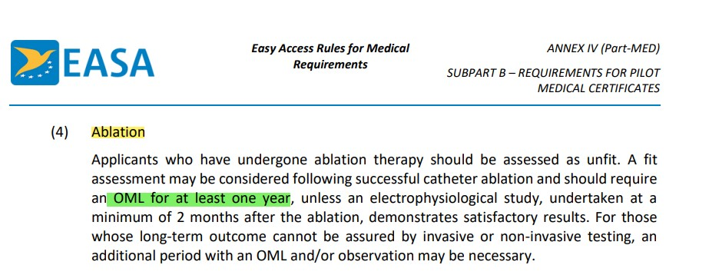
Class 1 ablation

Slide 46
Class 2 ablatie

Slide 47
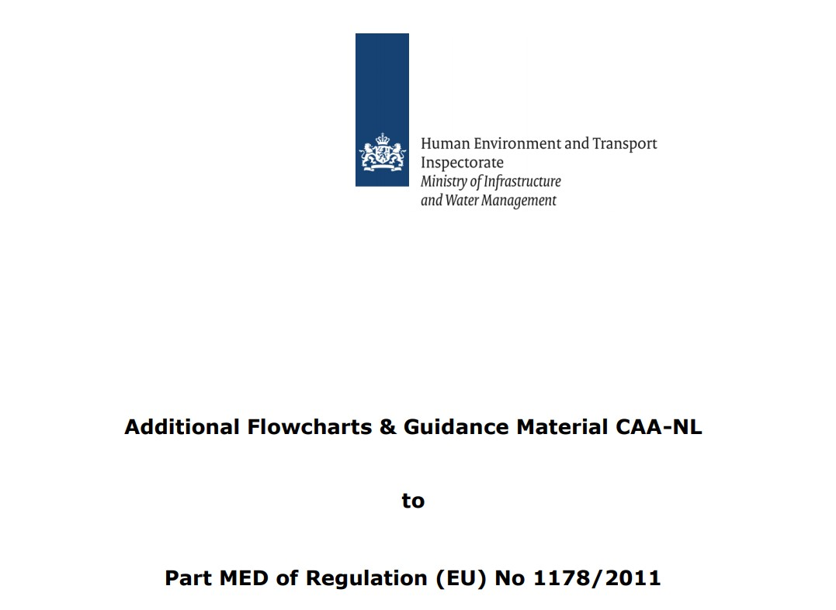

Slide 48
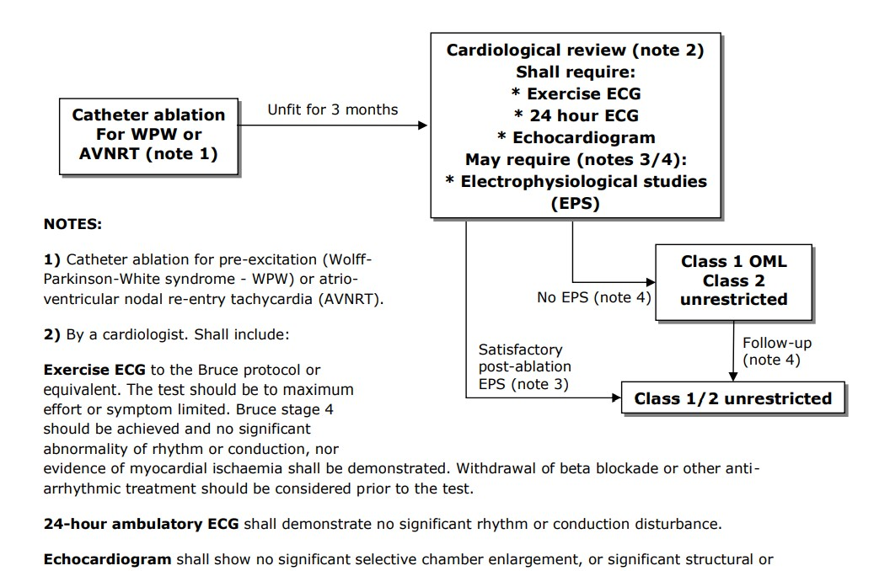

Slide 49
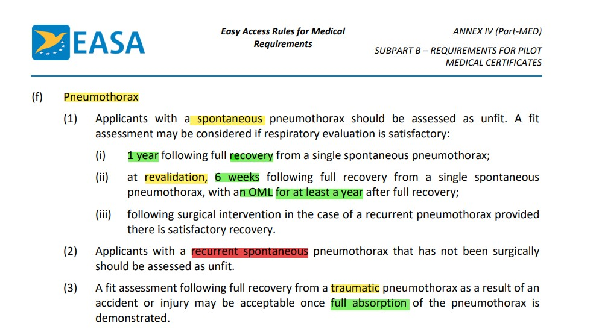
Class 1 pneumothorax

Slide 50
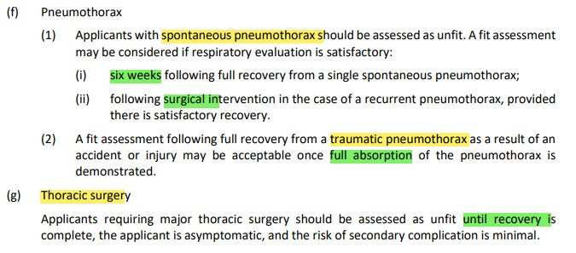
Class 2 pneumothorax

Slide 51
Abdominal surgery

Slide 52
Abdominal surgery
Major abdominal surgery : 3 months
Colectomy, hysterectomy
Laparoscopic procedure : 3-4 weeks
Inguinal hernia repair, cholecystectomie
Diagnostic laparoscopy : 1 week
Lower gastrointestinal tract endoscopy : 48h
Air trapped after laparotomy is absorbed within 1week
CO2 following laparoscopy is absorbed within 24 h

Slide 53
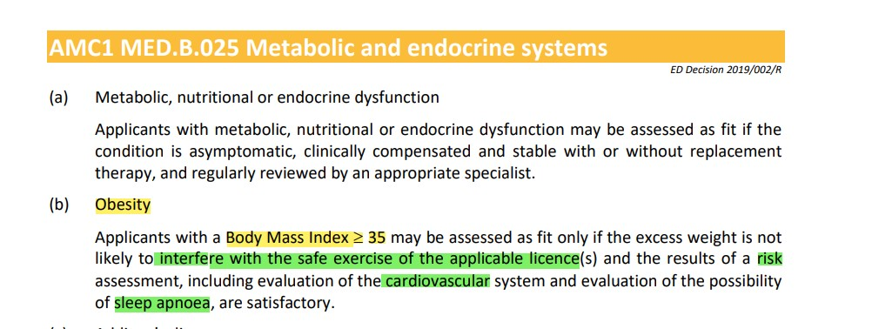
Class 1 obesity

Slide 54
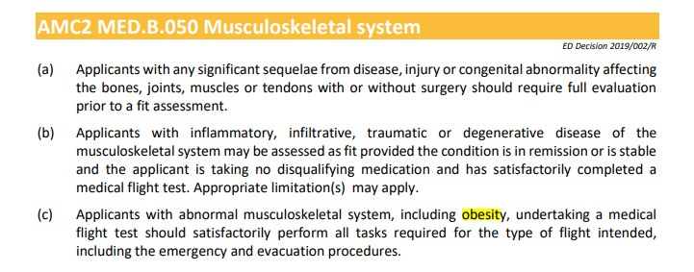
Obesity

Slide 55
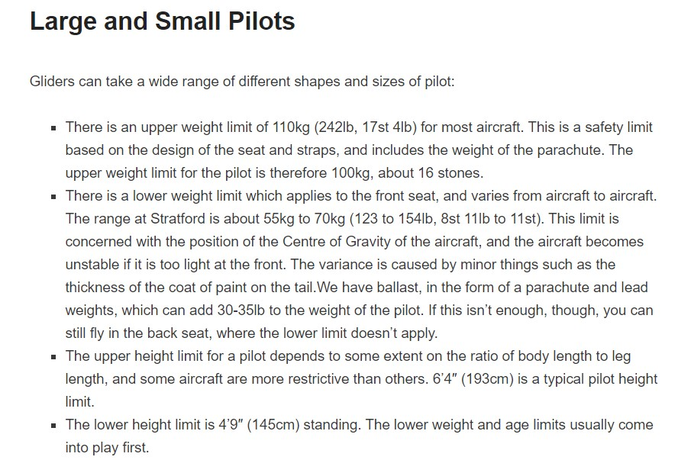

Slide 56
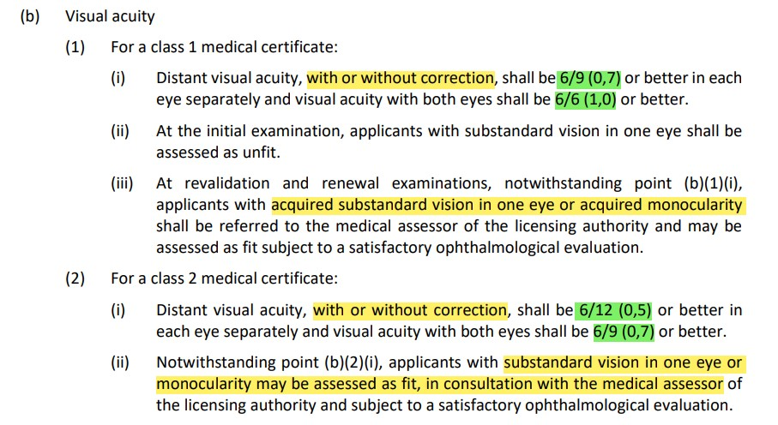
Visual acuity

Slide 57
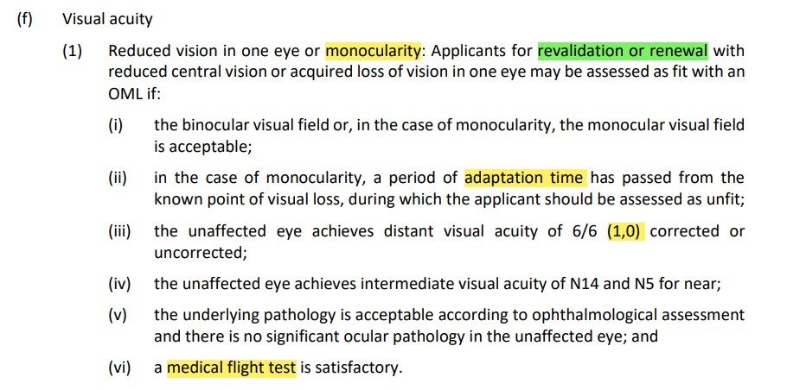
Class 1 monocularity

Slide 58
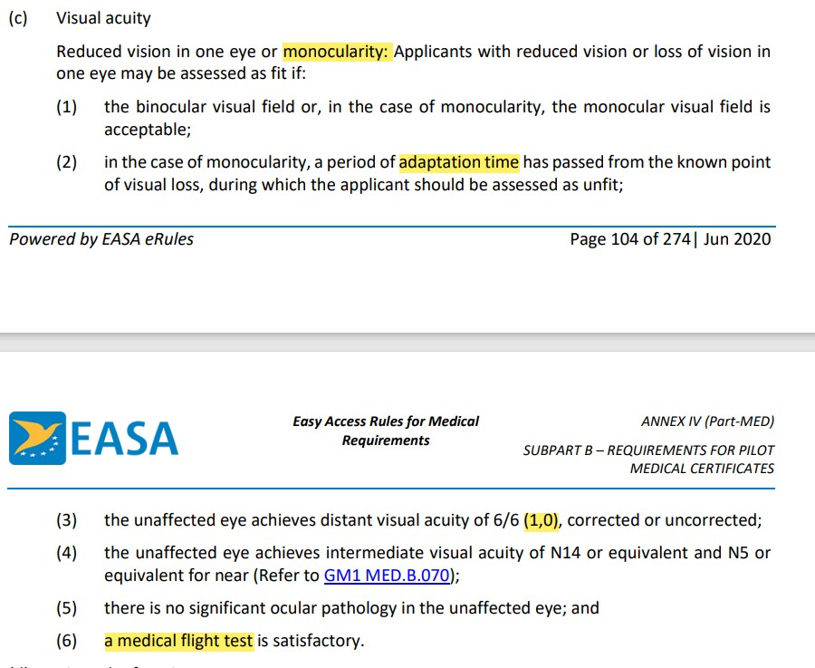
Class 2 monocularity

Slide 59
Class 1/2 Binocular function

Slide 60
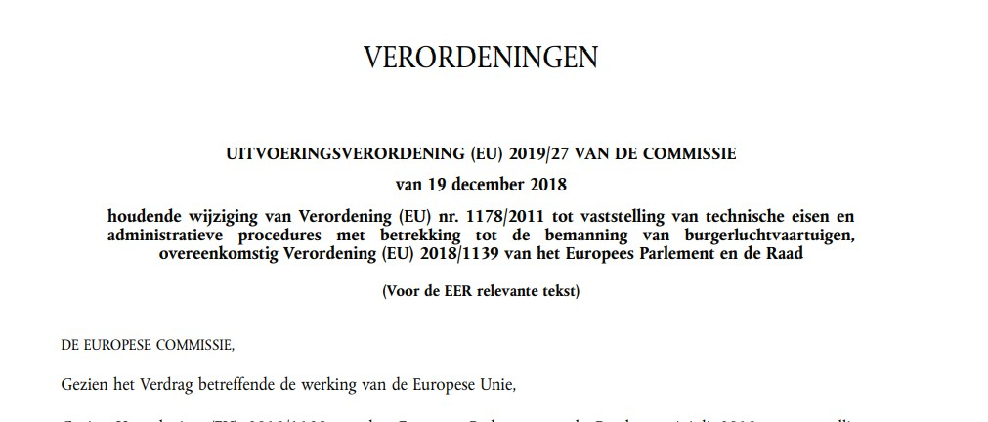
Verordening Contactlenzen

Slide 61
Contactlenzen

Slide 62
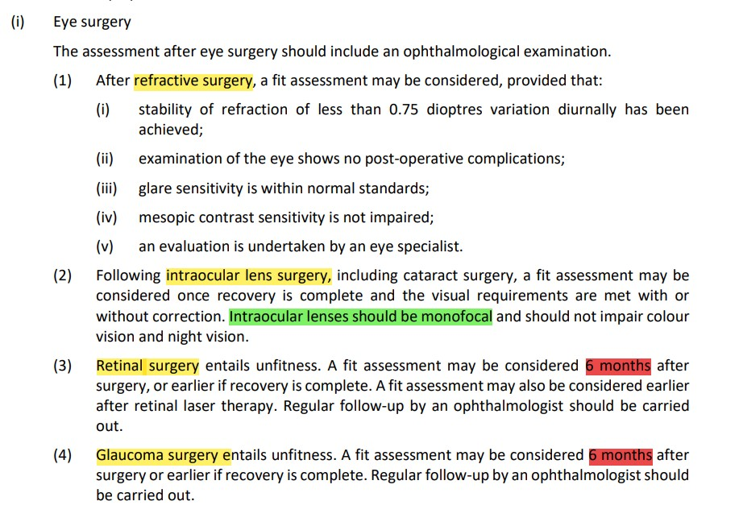
Class 1 Eye surgery

Slide 63
Class 2 eye surgery

Slide 64
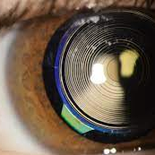
Multifocal IOL

Slide 65
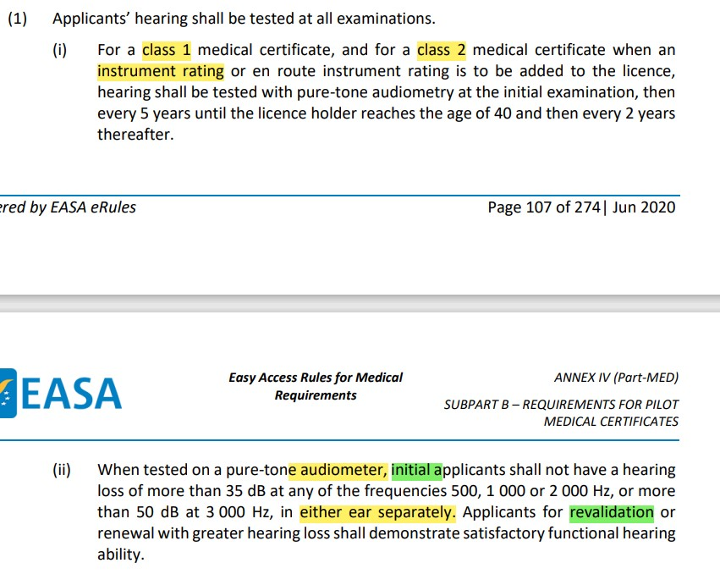
Class 1 hearing

Slide 66
Class 2 hearing

